Slide 1

RAJIV GANDHI INSTITUTE OF TECHNOLOGY
Department of Computer Science and Engineering
INTERNSHIP
FULL STACK WEB DEVELOPMENT
Presented By:
Madhu S (1RG20CS033)
Santhosh P (1RG20CS050)
Siri Vennela V(1RG20CS58)
Stincy Stephan (1RG20CS062)
Under the Guidance of:
Mrs. Kavyashree J
&
Mrs. Bhagyashri Wakde

Slide 2
CONTENTS
Abstract
Company Profile
Introduction
Tools Exposed
Detailed Analysis of Task Performed
About the Project
Internship Experience Overview
Benefits Of Internship
Project Outcome
Conclusion
References

Slide 3
ABSTRACT
In the envisioned responsive food restaurant webpage, we emphasize visual allure with enticing images of dishes and ambiance. Effortless navigation is ensured through intuitive menus, facilitating exploration of menu, specials, reservations, and contact details. A simplified reservation system enhances convenience, allowing easy booking for users. Social proof is emphasized, showcasing positive testimonials and real-time updates to bolster credibility. Optimized performance across devices ensures fast loading times, providing a seamless browsing experience. Altogether, this webpage embodies aesthetic appeal, functionality, and user-friendly features to engage visitors and drive them towards a delightful dining experience.

Slide 4
COMPANY PROFILE
Formation of company
Aqmenz Automation Private Limited is a private incorporated on 15th October 2018. It is classified as Non-Govt Company and is registered at Registrar of companies, Bangalore.
History of company
AAPL: Aqmenz Automation Pvt Ltd (AAPL), established in 2018 in RT Nagar, Bangalore, specializes in Mechanical Design & Automation, with a focus on Open- source Robotics.
INDOSKILL: A subsidiary platform of AAPL, INDOSKILL offers skill-oriented online training and hands-on experience in Industrial Automation and Product Design for students.
Expertise: AAPL excels in Open-source Robotics, Industrial Automation, and Product Design, leveraging technologies such as Python, Deep Learning, and Embedded Systems.

Slide 5
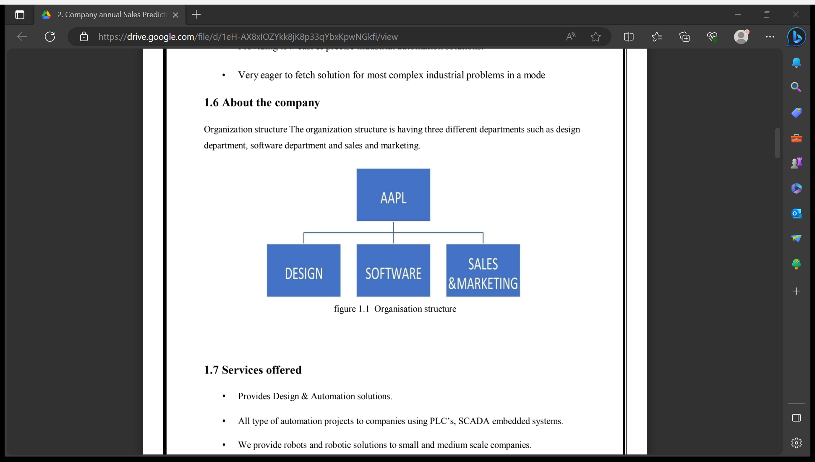
About the company
The organization structure is having three different departments such as design department, software department and sales and marketing.
fig 1: Organisation structure
Services Offered
Design & Automation solutions including PLC, SCADA, and embedded systems.
Robotic solutions for small and medium-scale companies, and embedded solutions for clients like GE. Additionally, technical skill-oriented training programs and robotics lab equipment provision for engineering colleges are provided.
Team Structure
A team of 20 persons led by Mr. Mohan V S, the Chief Executive Officer (CEO), and Mohammed Azhar Hussain, the Chief Technology Officer (CTO), overseeing operations and technological advancements respectively.

Slide 6
INTRODUCTION
In today's digital age, having a strong online presence is crucial for businesses, including restaurants. With more and more customers turning to the internet to discover new dining options and make reservations, having an engaging and user-friendly website is essential. This project aims to create a responsive food restaurant webpage that adapts seamlessly to various devices and screen sizes, providing an optimal viewing and interaction experience for users.
Project Goals
Responsive Design
User-Friendly Interface
Menu Showcase

Slide 7
TOOLS EXPOSED
Versatile Source-Code Editor
Visual Studio Code (VS Code) is a highly versatile and widely adopted source-code editor developed by Microsoft, renowned for its flexibility and robustness.
Intuitive Interface and User-Friendly Experience
With an intuitive interface, VS Code caters to both beginners and seasoned developers, offering extensive customization options to tailor the editor to individual preferences.
Cross-Platform Compatibility
VS Code ensures a seamless experience across Windows, macOS, and Linux, making it accessible to developers regardless of their operating system.
Extensive Extension Ecosystem
One of its standout features is the extensive extension ecosystem, allowing developers to customize the editor and enhance functionality according to their specific needs, thereby boosting productivity and efficiency.

Slide 8
DETAILED ANALYSIS OF TASK PERFORMED
Week 1 – HTML
HTML, an acronym for Hyper Text Markup Language, serves as the foundational structure for creating web pages. It is the standard language used to define the layout and content of a webpage, employing a series of elements to label different components such as headings, paragraphs, links, and more. Furthermore, the declaration <!DOCTYPE> signifies the document as being compliant with HTML5 standards, while the <html> element acts as the root element, encapsulating the entire webpage.
Week 2 – CSS
CSS, short for Cascading Style Sheets, dictates how HTML elements are presented across different media. It simplifies design tasks and allows for uniform styling across multiple web pages through external, internal, and inline styles. These styles are written using selectors, declaration blocks, and properties to control layout and appearance. External stylesheets, stored in .css files, offer the advantage of applying consistent styling to entire websites.

Slide 9
Week 3 – Bootstrap
Bootstrap is a widely-used front-end framework for web development. It offers pre-designed templates and components for building responsive websites. With its grid system and CSS classes, Bootstrap enables developers to create consistent layouts easily. JavaScript plugins enhance functionality, making it popular for rapid development.
Week 4 – JavaScript
JavaScript (JS) is a widely-used lightweight programming language for both client-side and server-side development, known for its versatility and dynamic capabilities. With over 1.4 million libraries, it's preferred by major tech companies like Microsoft, Google, and Netflix. JavaScript enhances website interactivity and complements HTML's structure, making it essential for modern web development.

Slide 10
ABOUT THE PROJECT
Project Overview
Developed a dynamic "Responsive Food Restaurant Webpage" during the internship to enhance the restaurant's online presence and user experience across devices.
Key Features
Implemented responsive design, visually appealing menu displays, simplified reservation system, and social media integration for enhanced user engagement.
Technological Implementation
Utilized HTML, CSS, and JavaScript to craft a modern interface with optimal performance and seamless browsing experience.
Outcome and Impact
Improved restaurant's online visibility and customer engagement through an intuitive and visually appealing webpage, contributing to its success in the competitive digital landscape.

Slide 11
INTERNSHIP EXPERIENCE OVERVIEW
Worked at AQMENZ AUTOMATION PRIVATE LIMITED.
Enhanced Google search skills for project requirements.
Benefited from informative and supportive seniors.
Gained insights into project development lifecycle and project management.
Improved communication, presentation, and coordination skills.
Acquired management, leadership, and client interaction experience.

Slide 12
BENEFITS OF INTERNSHIP
Gain valuable work experience and hands-on training.
Have an edge in the competitive job market with practical experience.
Transition smoothly into full-time employment with successful internships.
Network with industry professionals for future career opportunities.
Apply classroom knowledge in real-world scenarios, boosting confidence and employability.

Slide 13
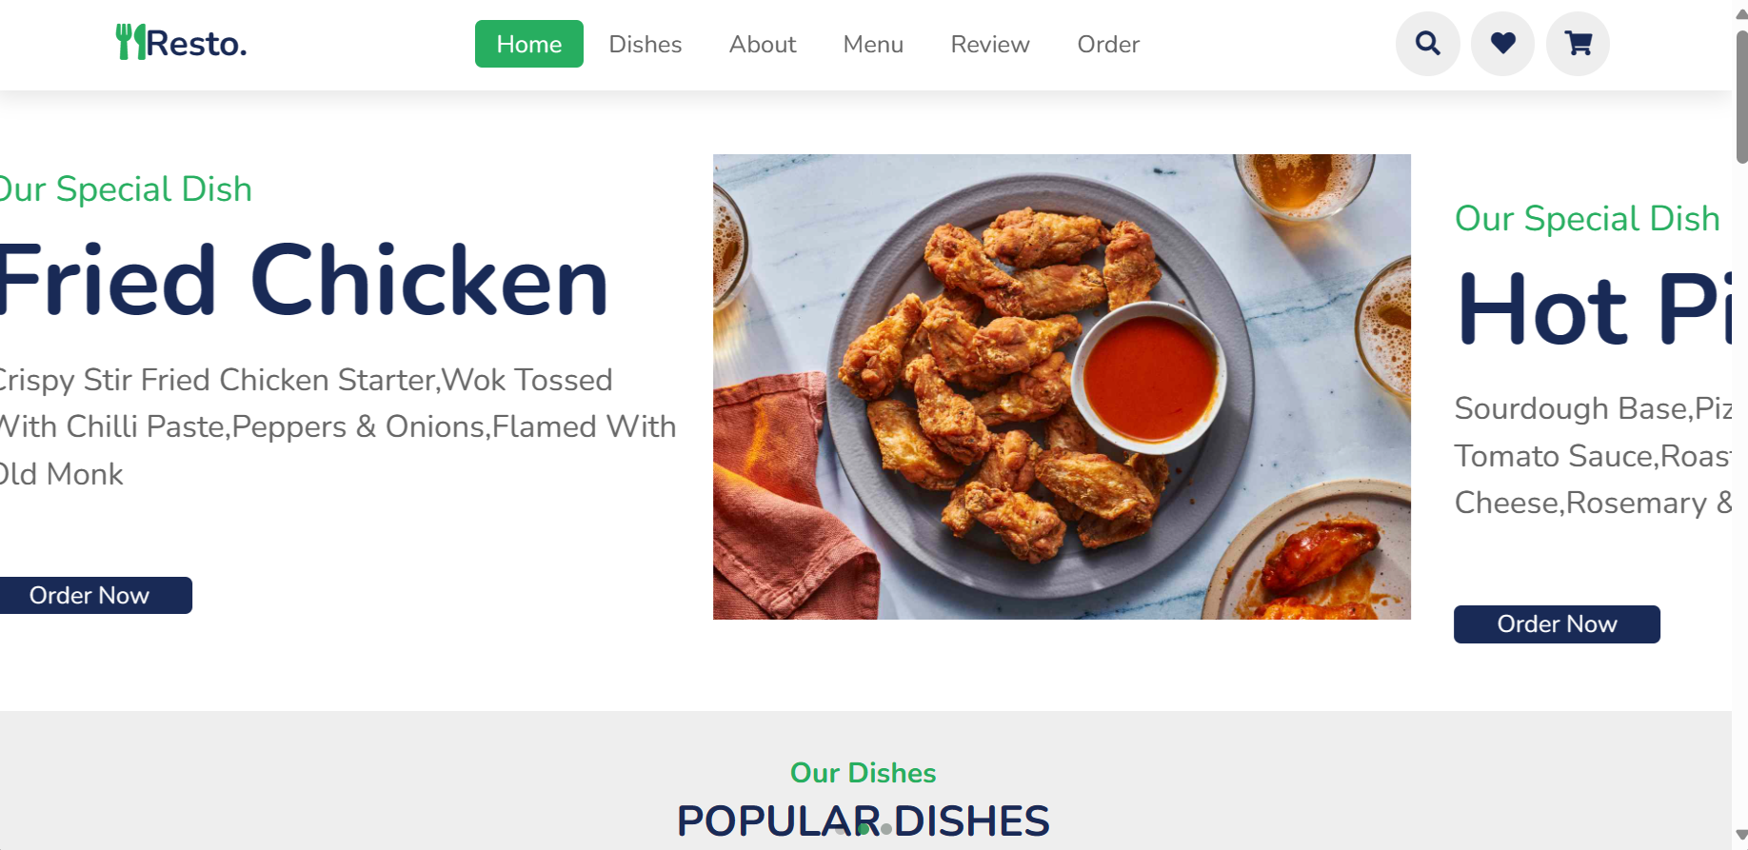
Project Outcome:
1.Home Page

Slide 14
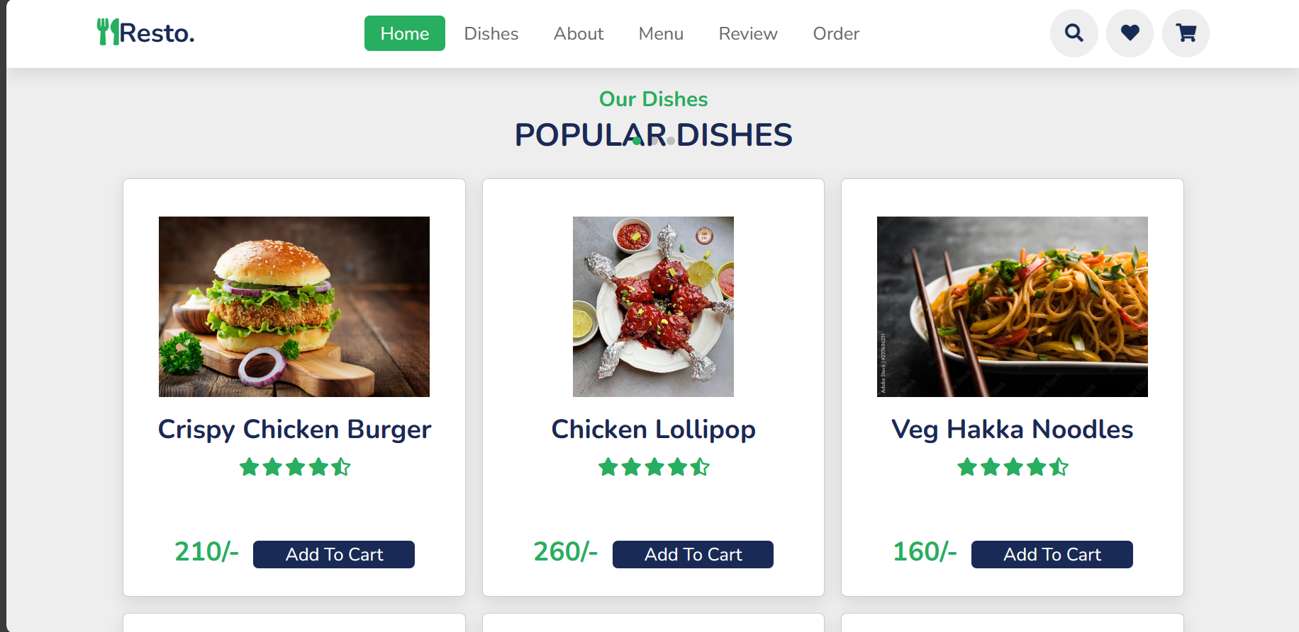
2. Dishes

Slide 15
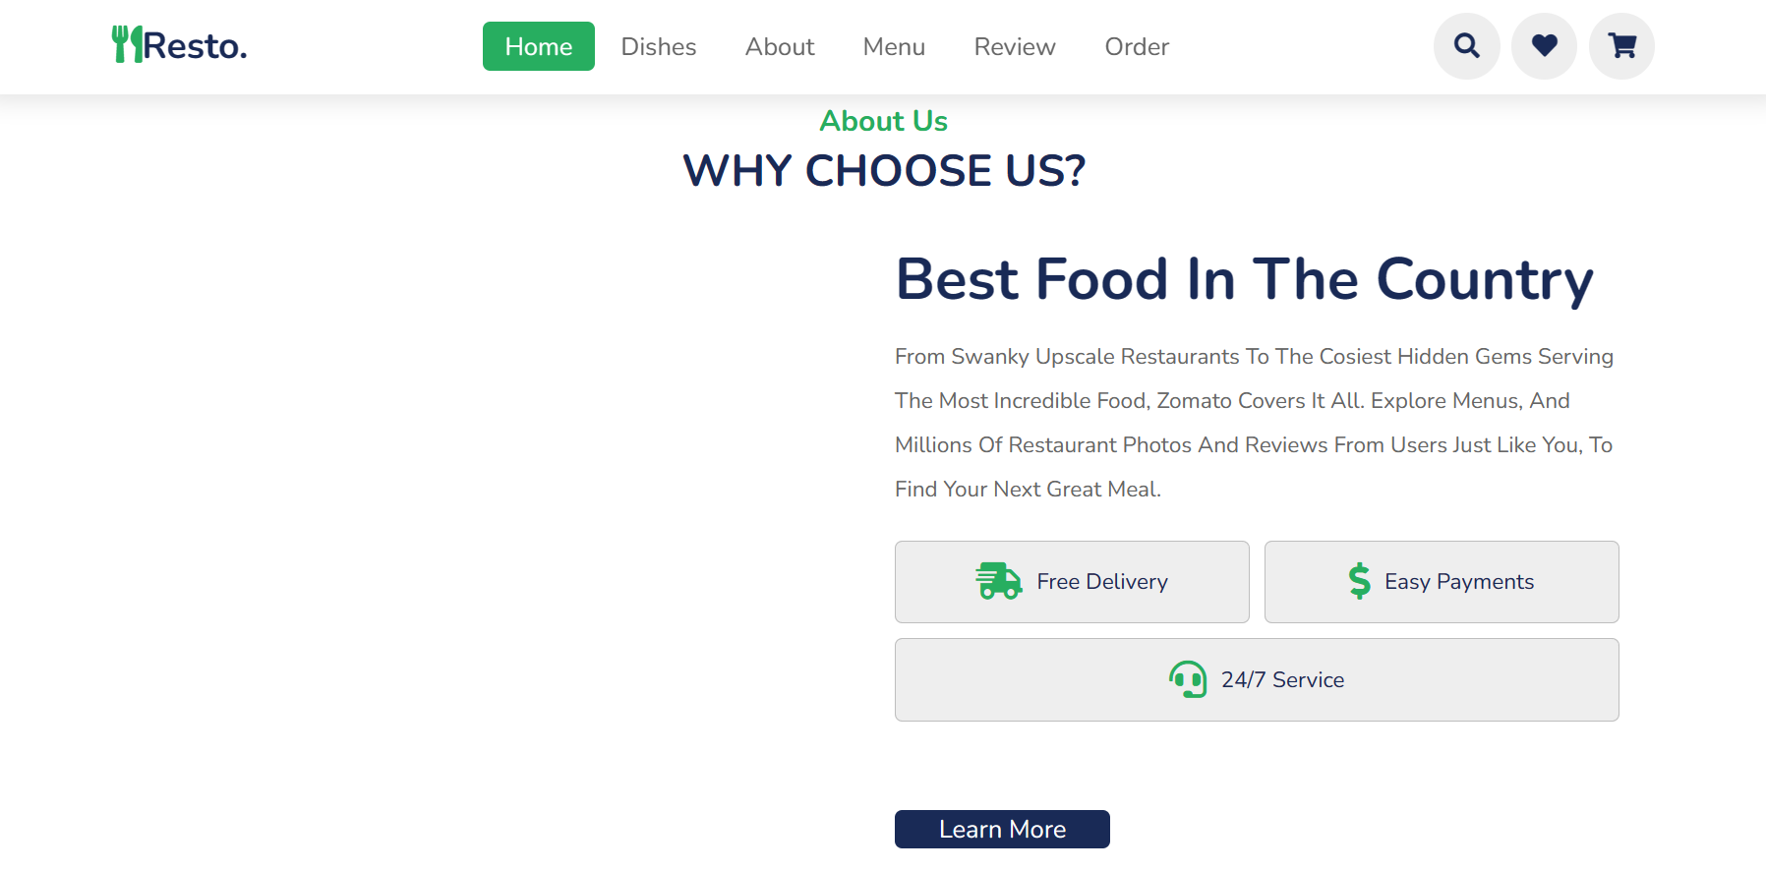
3. About Us Page

Slide 16
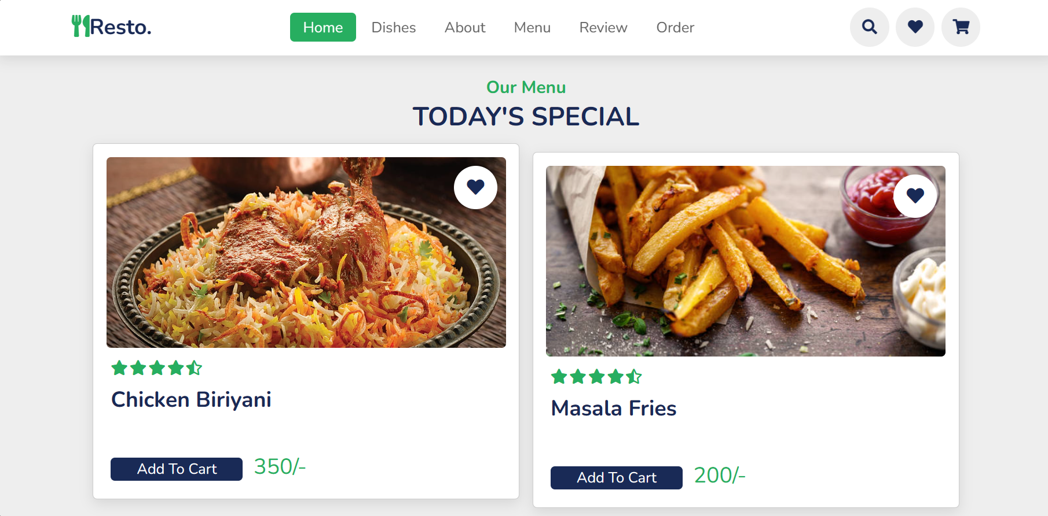
4. Special Menu Page

Slide 17
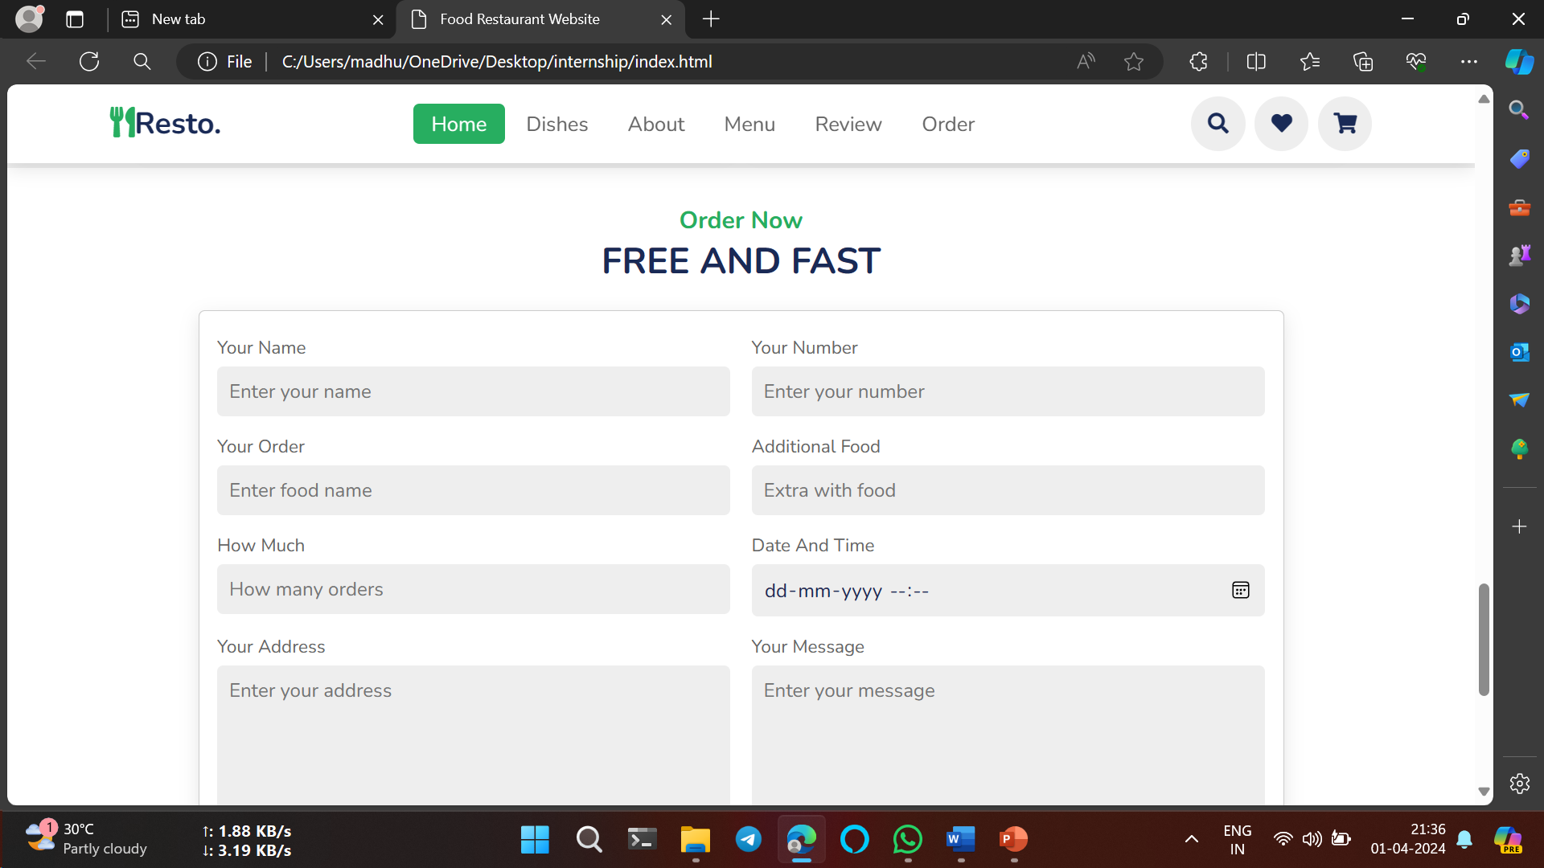
5.Food Ordering Page

Slide 18
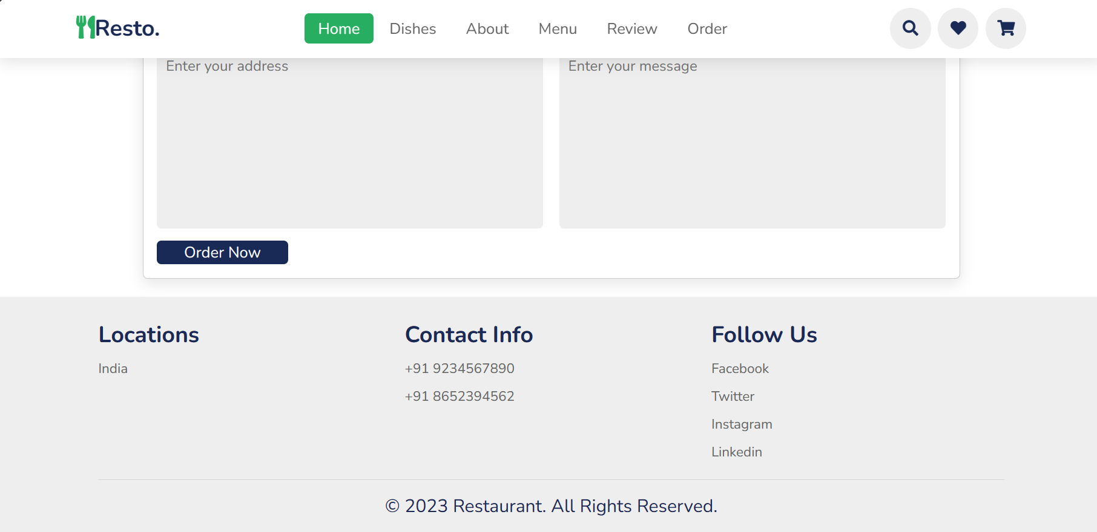

Slide 19
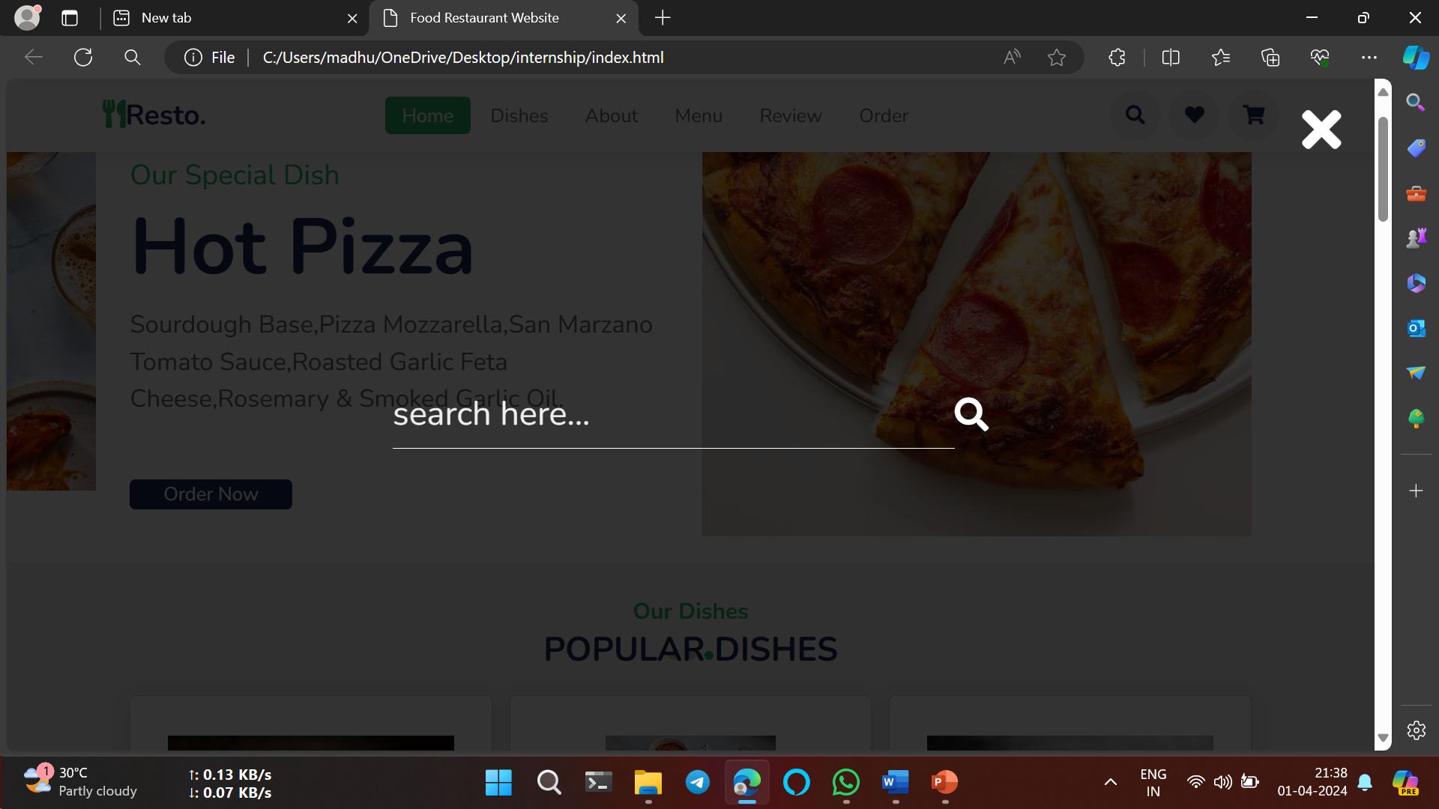
6. Search Bar

Slide 20
CONCLUSION
Our restaurant's responsive food webpage offers a seamless user experience across devices, enabling easy menu access, ordering, and updates. Prioritizing fast loading times and a mobile-first approach, we ensure optimal functionality and aesthetics on all screens. The flexible layout adjusts smoothly, maintaining legibility and intuitive navigation. With a user-friendly interface, customers can effortlessly browse the menu, view enticing images, and place orders. Social media integration encourages sharing, enhancing engagement and extending our reach. Committed to excellence, we continuously adapt to technology and customer needs to deliver a delightful online dining experience for all.

Slide 21
REFERENCES
https://www.codecademy.com/learn/introduction-to-javascript
http://www.w3schools.com/html/html_intro.asp
http://www.Udemy.com/css/css_background.asp
http://www.w3schools.com/js/js_datatypes.asp
https://javapoint.com

Slide 22


Slide 23


